Slide 1

Mutation and sequence analysis
Jeffrey Chuang
The Jackson Laboratory for Genomic Medicine
May 2018

Slide 2
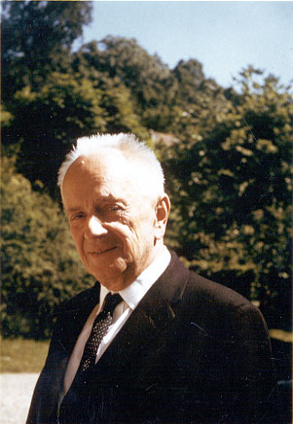
Mutations and Evolution
”Nothing in biology makes sense, except in the light of evolution.
Without that light it becomes a pile of sundry facts - some of them interesting or curious but making no meaningful picture as a whole”
-Theodosius Dobzhansky

Slide 3
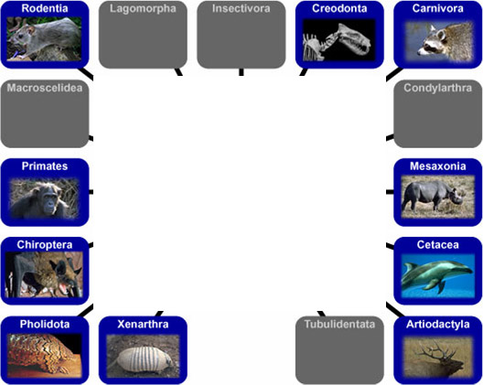
Classification as a motivation for sequence analysis
?
How should different species be understood? If they are related, then in what way?

Slide 4
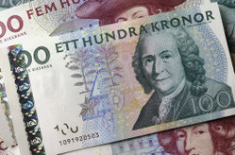
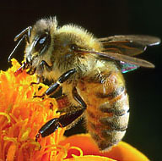
Pre-genomic classification
● Hierarchical classification
(Carolus Linnaeus, 1707-1778)
● Binomial nomenclature
Name Pre-Linnaeus: Apis pubescens thorace subgriseo abdomine fusco pedibus posticis glabris utrinque margine ciliatis.
Name Post-linnaeus: Apis mellifera.

Slide 5
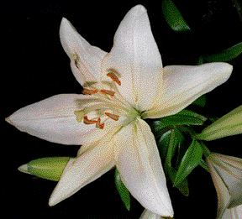

Genomic characters for classification
Traditional classification based on arbitrary morphological characters.
Example: number and arrangement of plant reproductive organs.
Molecular sequence data is universal (A, C, G, T), digital (4 nts), and abundant (millions to billions of bases per genome)

Slide 6
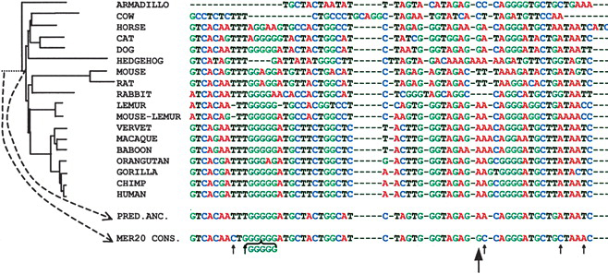
Modern classification is based on sequence evolution
Mathieu Blanchette et al. Genome Res. 2004; 14: 2412-2423

Slide 7
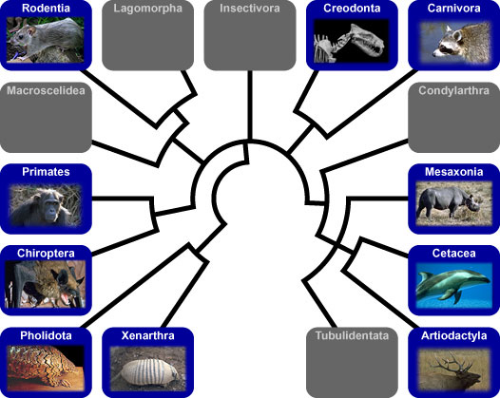
Modern classification is based on sequence evolution
PLOS:Computational Biology, 2006, 2:1499

Slide 8
Sequence Comparison
Cross-species analysis
Assemble genomes,
Align regions of interest
Count differences across species
Intraspecies analysis
Align reads to reference,
Count differences to reference
To compare samples, repeat steps (1) and (2) for each sample.

Slide 9
Sequence comparison leads naturally to topics on:
Phylogenetics
Evolutionary analysis from high-throughput sequencing data
Computational methods

Slide 10
Phylogenetics
Traditional, well-covered topic.
Tree-building methods
Distance metrics
Species evolution

Slide 11
Evolutionary sequence analysis

Slide 12
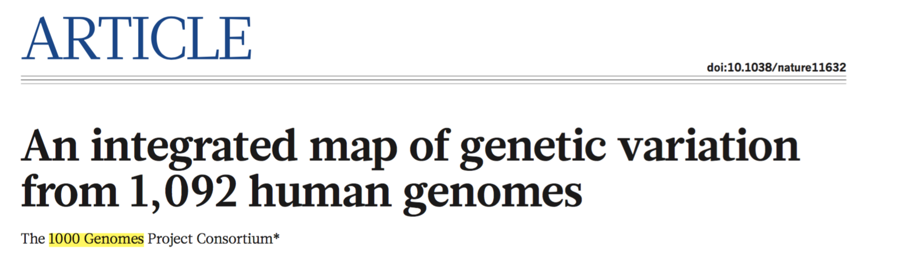
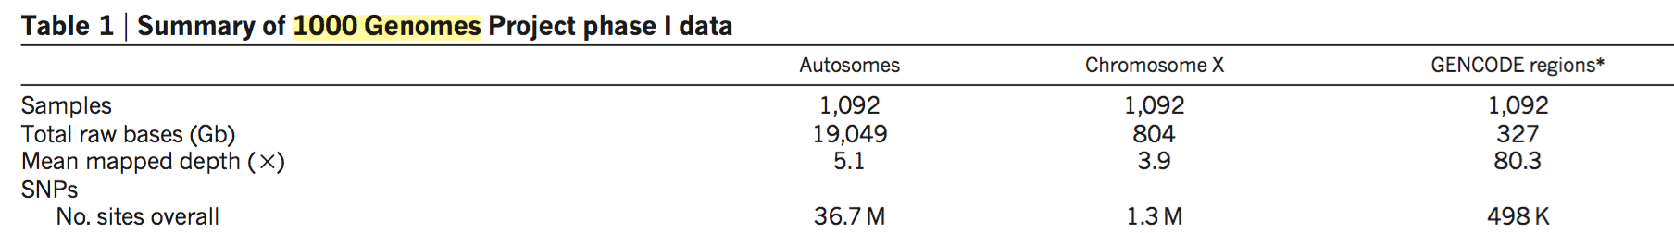
The 1000 Genomes Project
1000G project identified 1 SNP per 100 nt. 5x whole genome sequencing per individual; 80x in gene regions.
1000 Genomes Project Consortium et al. Nature 491, 56–65 (2012).

Slide 13
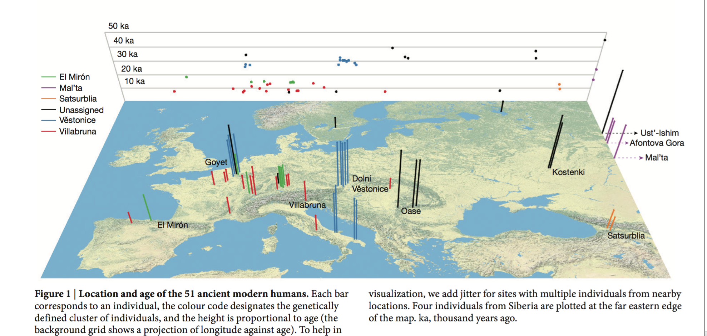
Human population evolution
Analysis of polymorphism data allows for detailed reconstruction of population history
Fu, Q. et al. The genetic history of Ice Age Europe. Nature (2016). doi:10.1038/nature17993

Slide 14
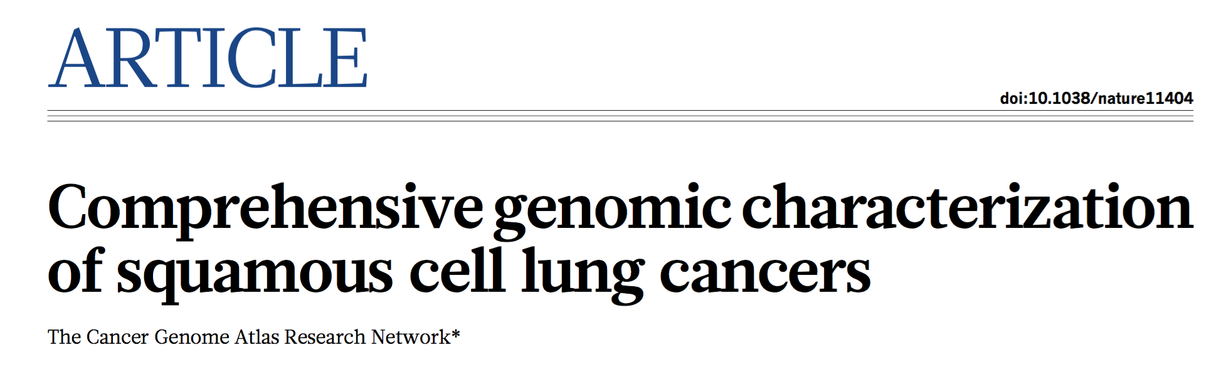
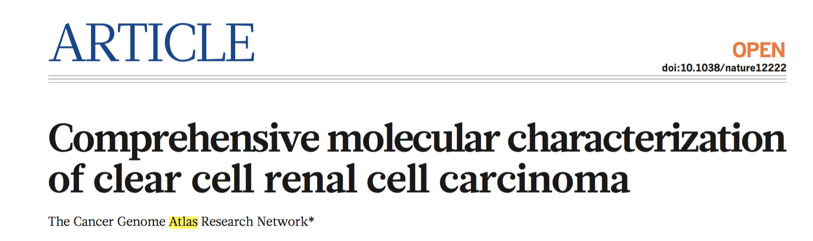
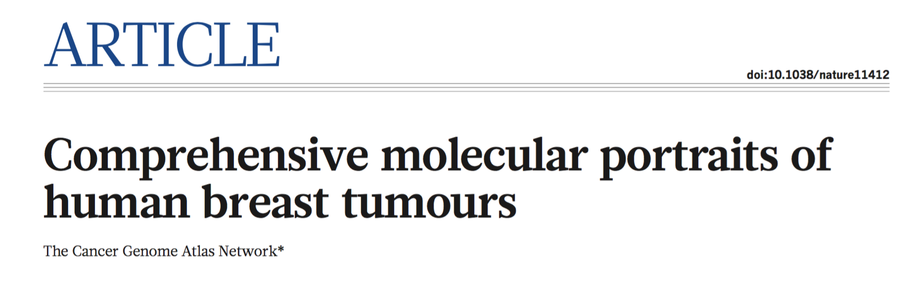
The Cancer Genome Atlas

Slide 15
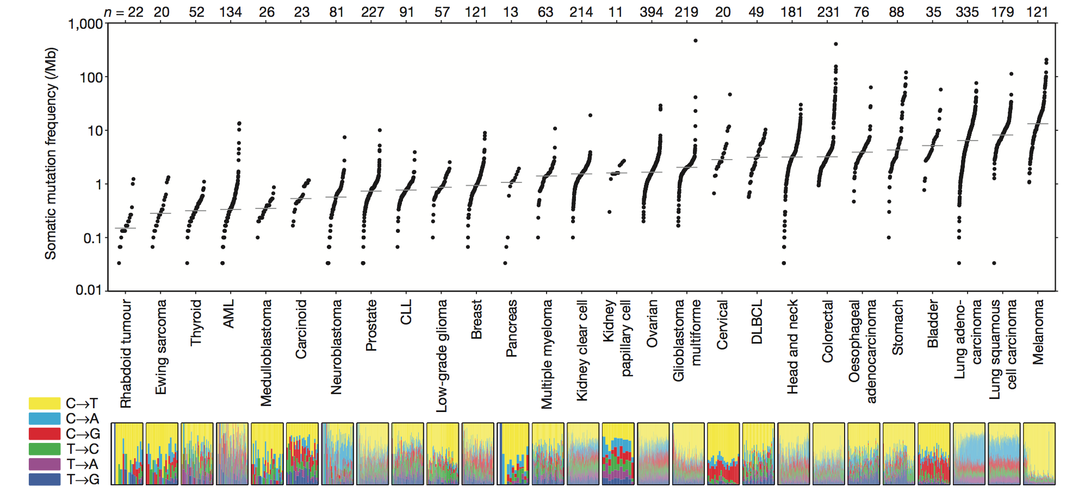
Mutations in cancer
Mutation rates vary across different cancer types
Lawrence, M. S. et al. Nature 499, 214–218 (2013).

Slide 16
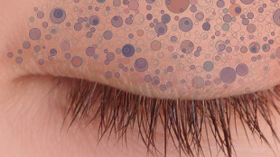
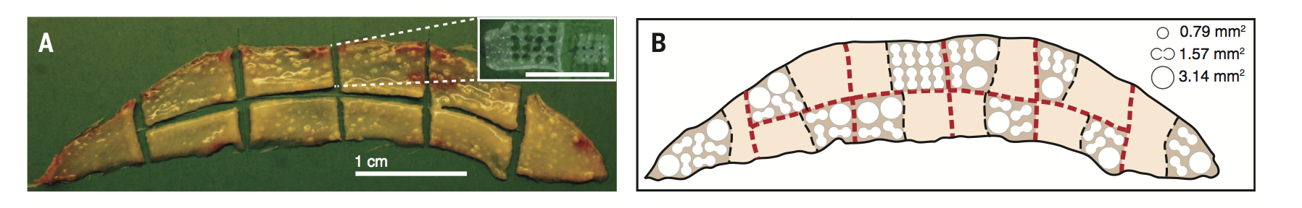
Example: high-depth sequencing of multiple regions of eyelid skin
Representation of mutant clones in normal eyelid skin.
Martincorena et al. Science 348:6237 (2015).
Excised human eyelid obtained via cosmetic surgery.

Slide 17
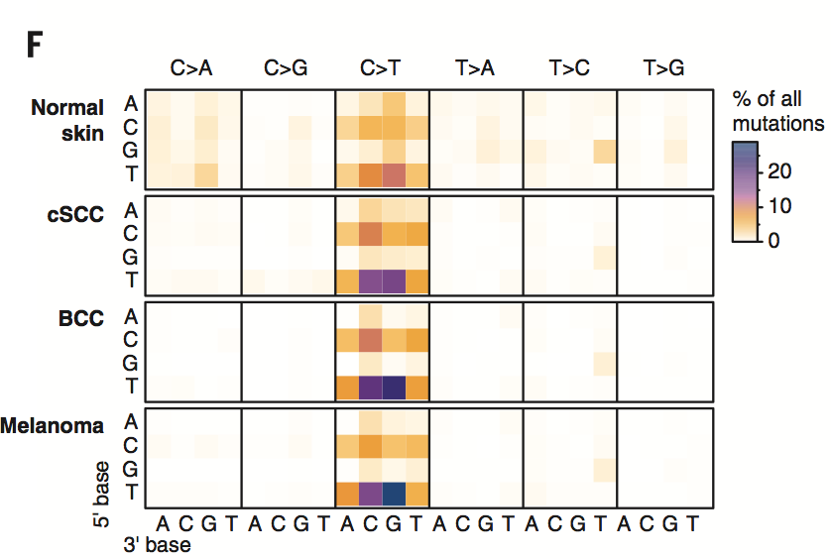
Mutations are similar across normal skin and skin cancers
Heat map of rates of each mutation type, depending on the nucleotides upstream and downstream of the mutated base.
SCC = squamous cell carcinoma. BCC = basal cell carcinoma

Slide 18
Computational Methods

Slide 19
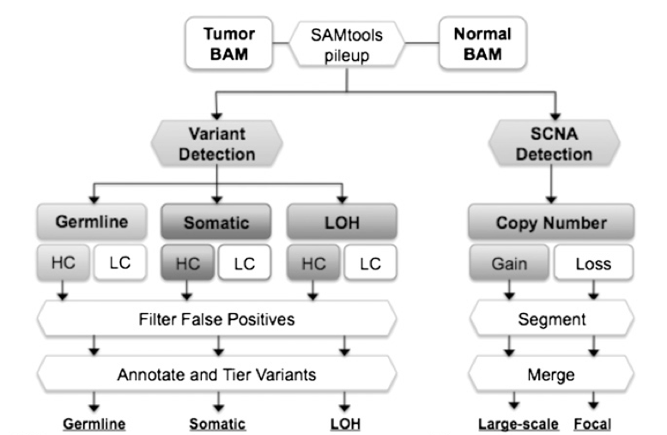
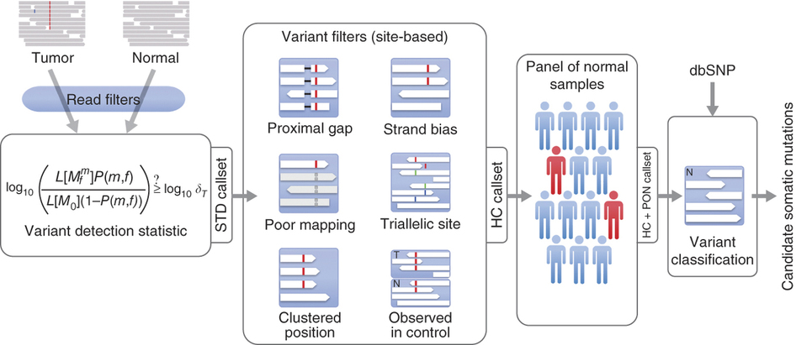
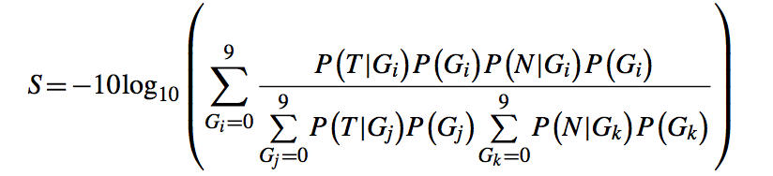
Examples of Mutation Callers
MuTect
Varscan
SomaticSniper
Cibulskis et al. Nature Biotechnology (2013)
Koboldt et al. Genome Research (2012).
Larson et al. Bioinformatics (2011).
There are a variety of computational pipelines that compute mutations from sequencing data.
Broader resources: Genome Analysis Toolkit (GATK), GenomeSpace, Galaxy, KnowEng, et al.

Slide 20
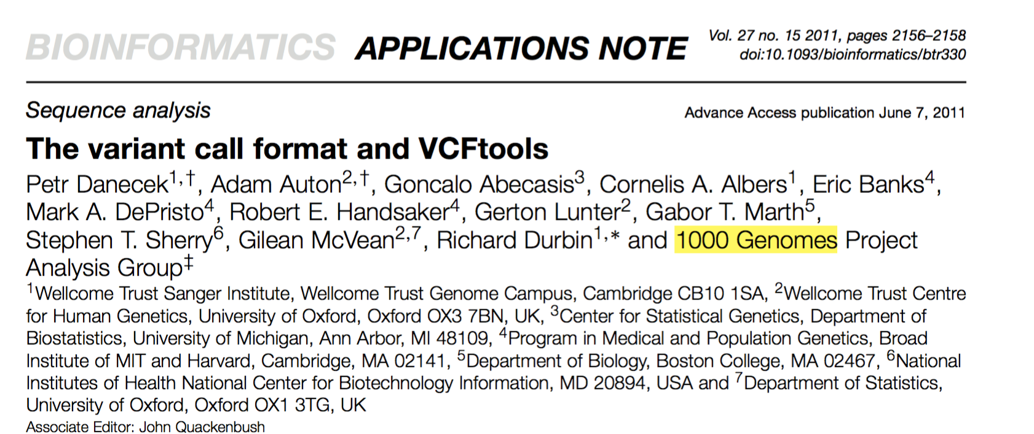
Variant Call Format files
Polymorphism data is stored in VCF files.

Slide 21
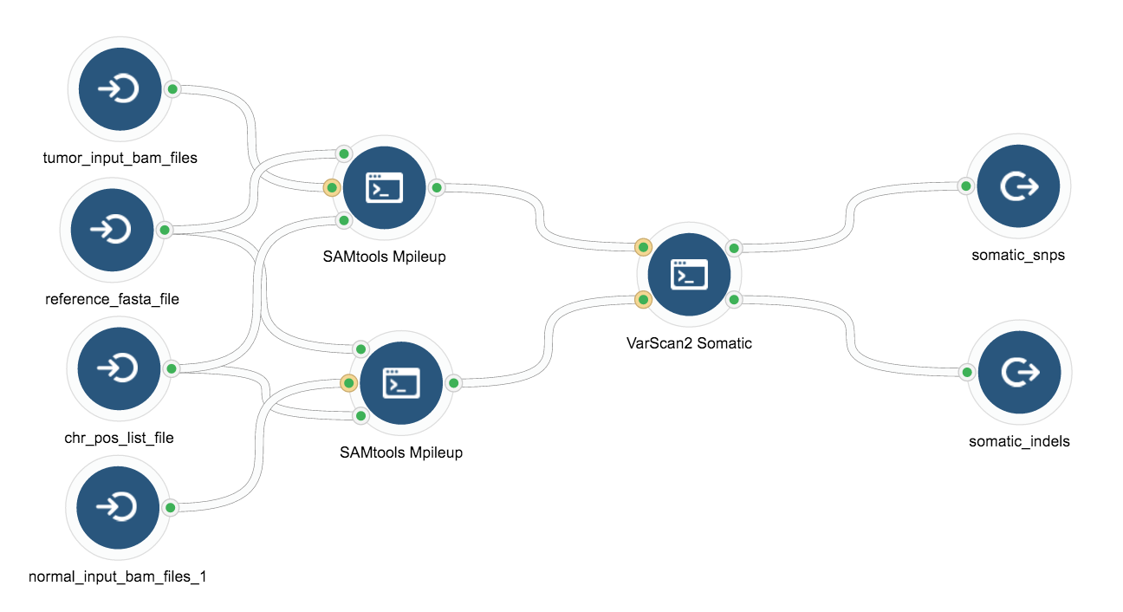
Example mutation calling pipeline in graphical workflow
Seven Bridges Genomics

Slide 22
Exercises

Slide 23
Driver mutation exercise
Download file “cancer driver data-1.xls”.
These are mutation data from 3 tumors (ME050, ME100L, ME024) of the same type, and they share a common driver mutation. Try to identify the common driver.
Don’t look up this reference until you have attempted to identify the driver. Nature 485, 502–506 (24 May 2012) doi:10.1038/nature11071

Slide 24
Driver mutation exercise solution
Copy the column Protein_Change to a text file named test.txt.
Open R
Read the file into R: data=read.csv(“test.txt”)
Find mutations that appear repeatedly: sort(table(data))

Slide 25
TCGA cancer exercises
Go to http://www.cbioportal.org/
Verify the mutation from the prior example by analyzing the Melanoma Broad/Dana Farber, Nature 2012 dataset. View the mutations in this set by going to the Data Sets tab in cBioPortal and selecting this set.
What are the 4 most commonly mutated genes in this dataset?
Why do you think the top 3 genes are more commonly mutated than the one you found in the Driver Mutation exercise? Useful link: Ensembl.http://www.ensembl.org/Homo_sapiens/Info/Index
What is the most commonly mutated gene in breast cancer? What is the typical diagnosis age? Use data from the Breast Invasive Carcinoma project. 1002 cases (TCGA Cell 2015).

Slide 26
Example pipeline exercise
Identify and validate coding variants from exome sequencing data
http://recipes.genomespace.org/view/17
This is a good example for mutation calling using the program FreeBayes and data publicly available on GenomeSpace.
We won’t execute this in class because data transfer and compute times are too long. This would be a good homework assignment for students.

